Slide 1
人教版初一英语10单元听力测试

Slide 2
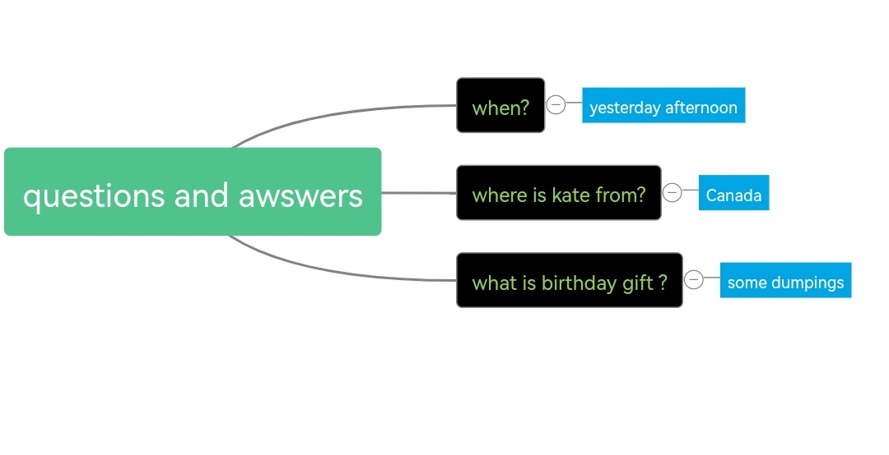

Slide 3

听短文，根据短文内容，完成下面表格。
Yesterday afternoon, Kate invited me to her party. I was happy because she often helps me with my English. I hope to talk with more people who speak English. Her family is from Canada. They all speak English. My mother knew Kate liked dumplings and made some for her. Kate's friends had been in the room when I got there. She told me she liked the dumplings very much. The party star-1ted at five and we all sang " Happy Birthday" to her. She asked us to talk in English. We had a good time and learned a lot, too.

